Slide 1
Principles and Elements of Art
Studio Art One Ms. Stancati

Slide 2
Principles of Art
These are the methods or techniques that artists use to develop, organize, and design artwork by controlling and maintaining some level of order of the elements of art.

Slide 3
Principles of Art (The recipe)
Balance
Emphasis
Movement
Pattern
Repetition
Proportion
Rhythm
Variety
Unity

Slide 4
Elements of Art (the ingredients)
These are the building blocks used by artist to create a work of art
• line shape • form • space •color • value

Slide 5
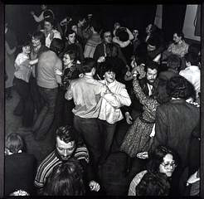

Slide 6
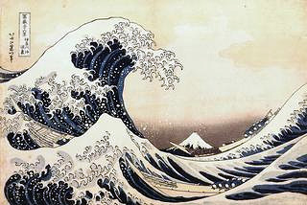

Slide 7
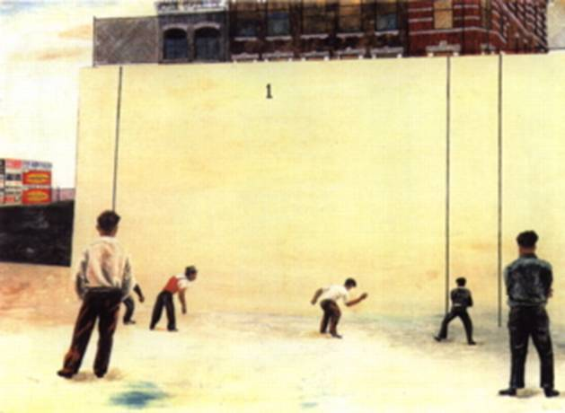

Slide 8
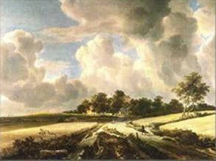

Slide 9
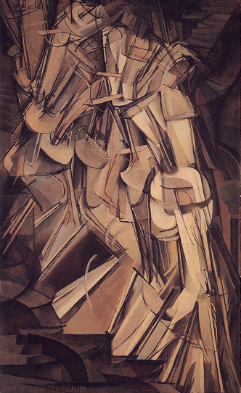

Slide 11
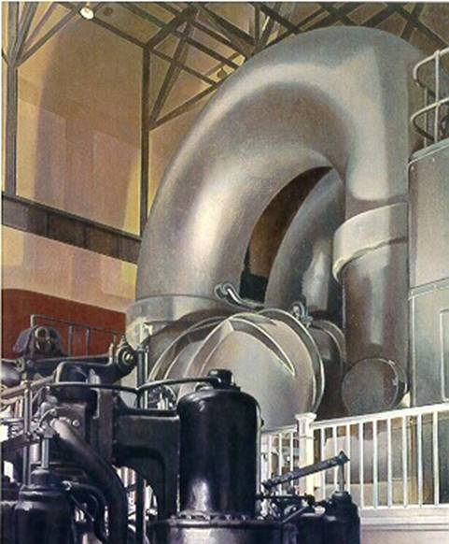

Slide 12
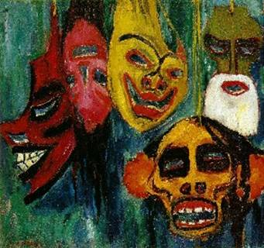

Slide 13
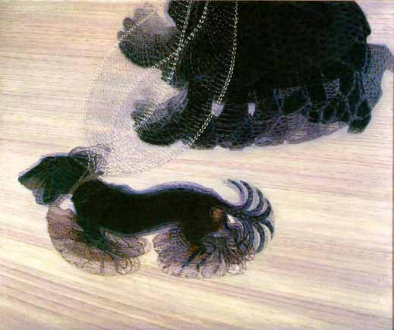

Slide 14
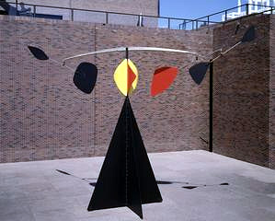

Slide 15
