Slide 1
Mind Maps
A mind map is a diagram used to represent words, ideas, tasks, or other items linked to and arranged around a central key word or idea.

Slide 2
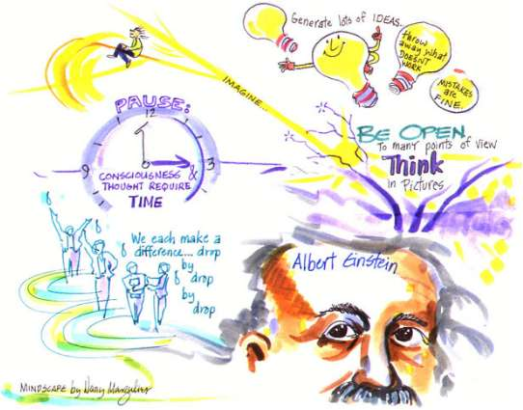

Slide 3


Slide 4
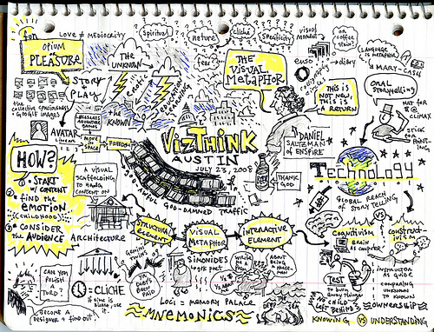

Slide 5
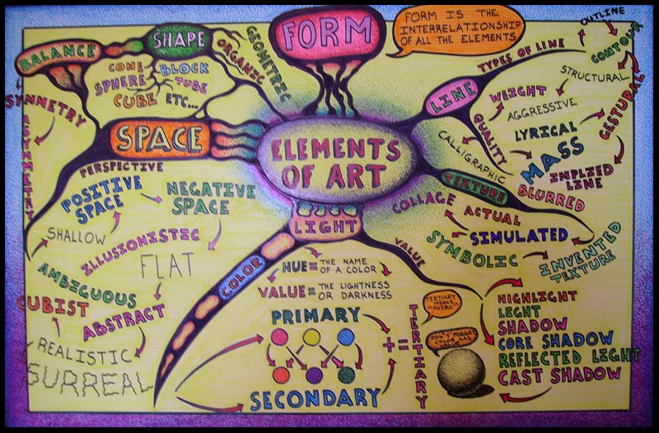

Slide 6
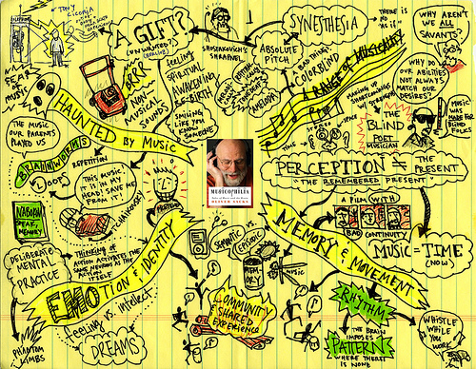

Slide 7
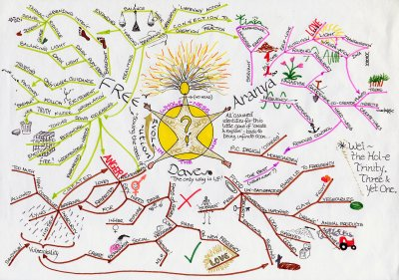

Slide 8
What are some possible themes?
How to do something for example:
How to ice skate
How to dance
How to cheat on a test
How to buy a pair of jeans
How to make friends

Slide 9
Use Words or ideas for example:
Create a map that illustrates a word
Anger, sadness, happiness
Map an Idea:
School beautification, school recycling

Slide 10
Due date: Wednesday November
Create 2 mind maps

